Slide 1
CHEESEBAE
Insert spinning_really_cool_3D_cheese.gif

Slide 2
The Problem?
Want to buy cheese but hate going outside?​
Do you love cheese but need more excitement in your life?​
CheeseBae is here to solve all your problems.​
CheeseBae is a marketplace where you can purchase boutique and exotic artisan cheeses and have it delivered straight to your door.​

Slide 3
Solving The Problem
This problem needed solving because cheese lovers and enthusiasts would be able to experience new tastes of cheese and so newcomers to artisan fromage will have a wide palette to choose from.​

Slide 4
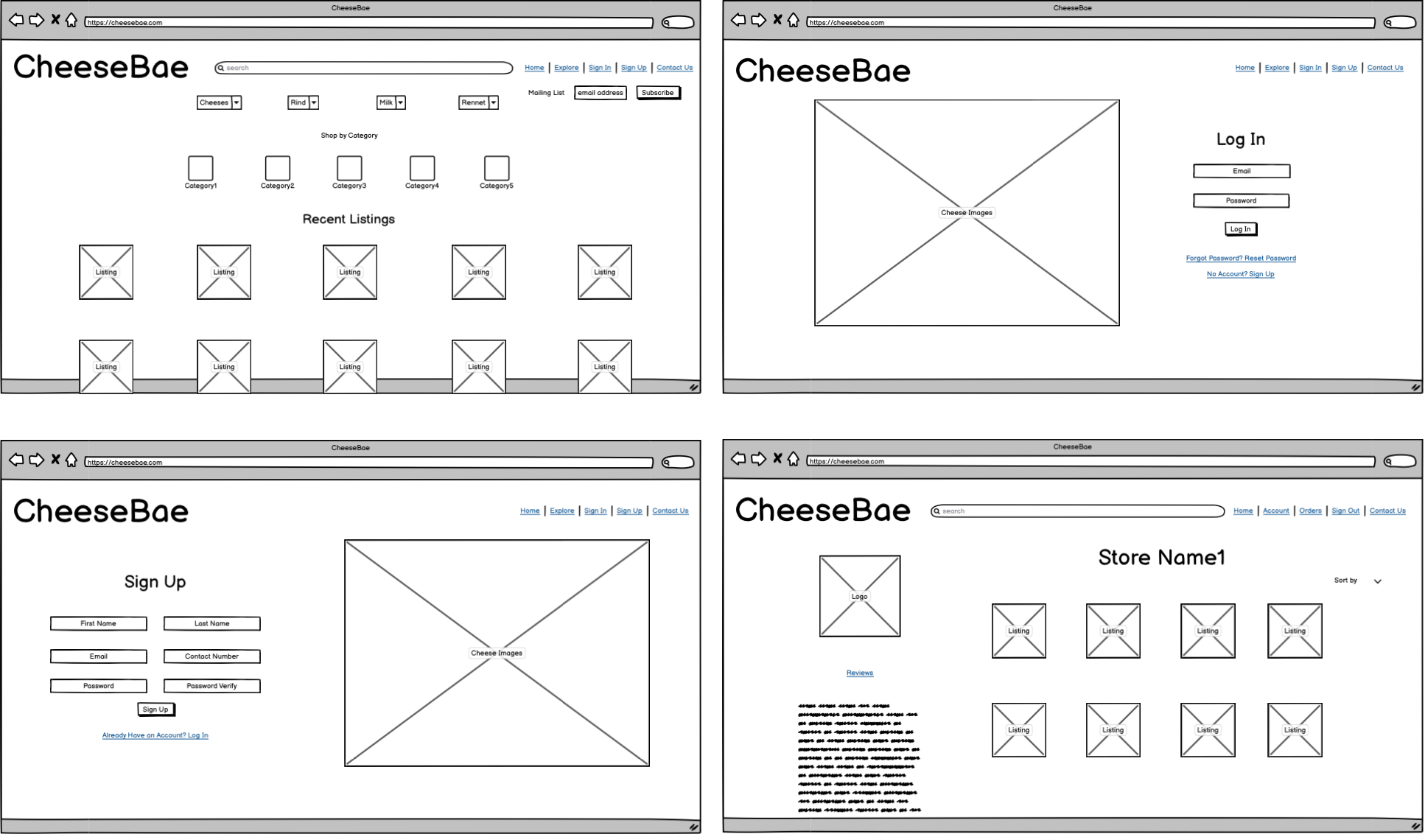
WIREFRAMES I DIDN’T USE

Slide 5
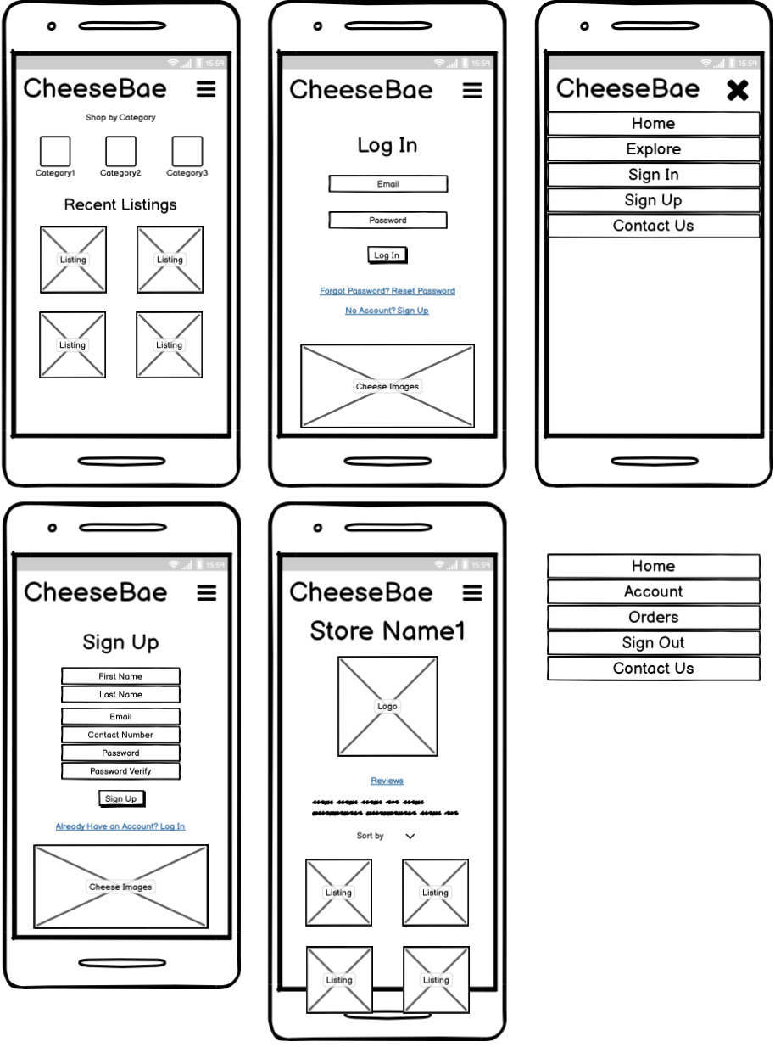
ALSO DIDN’T USE THESE

Slide 6
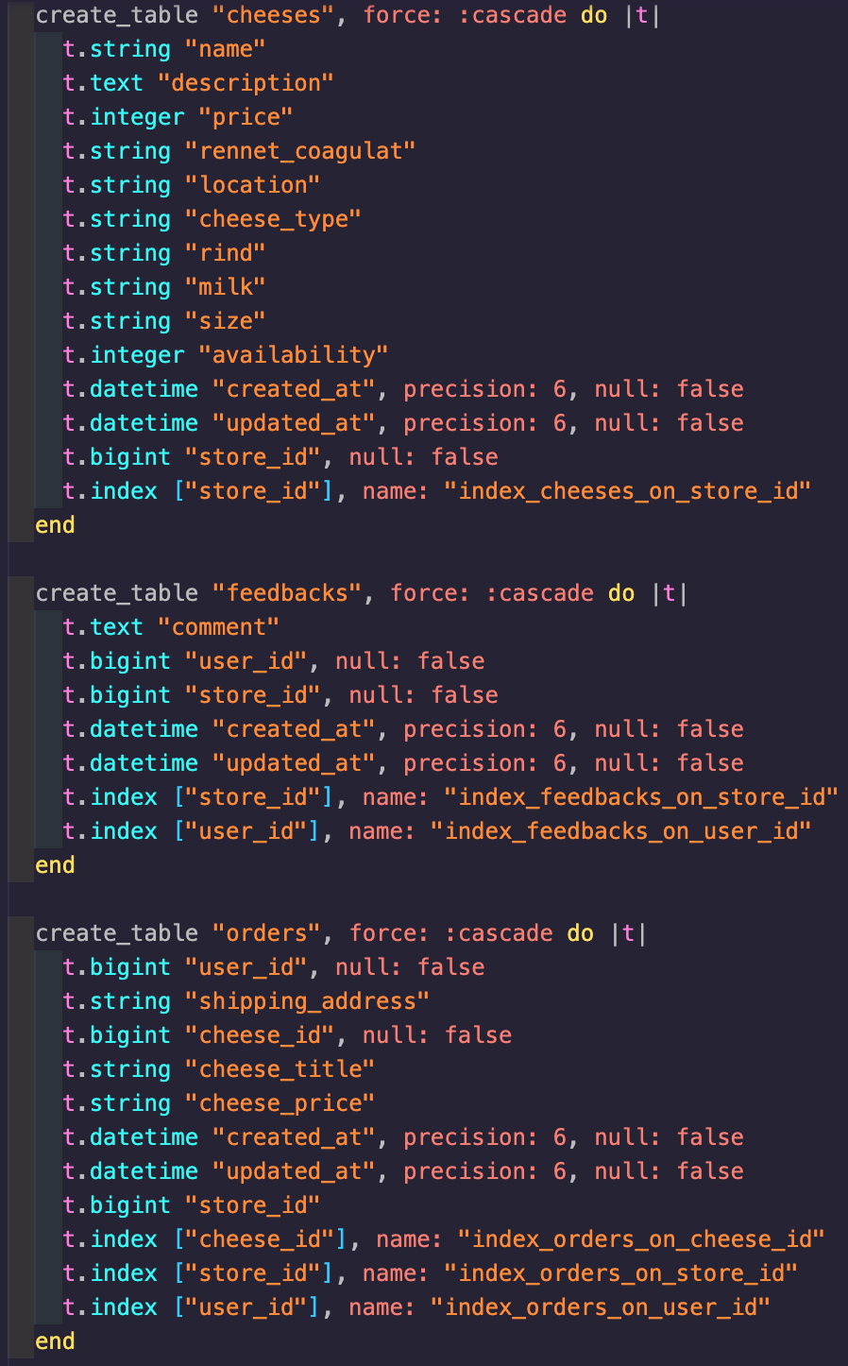
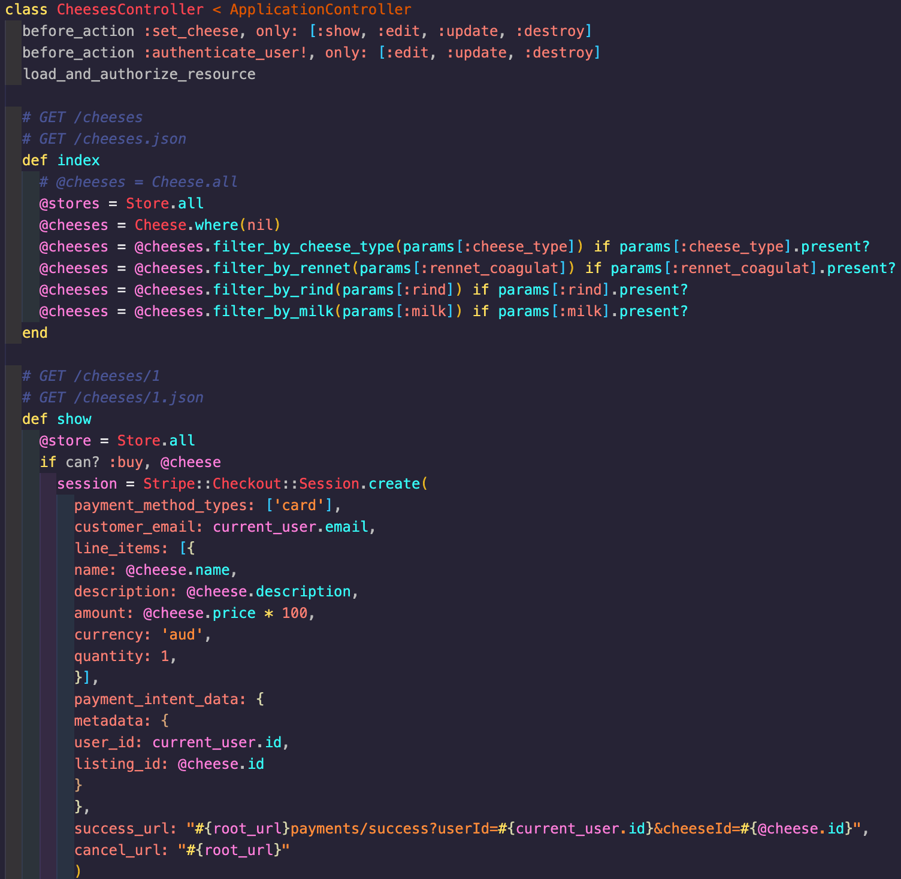
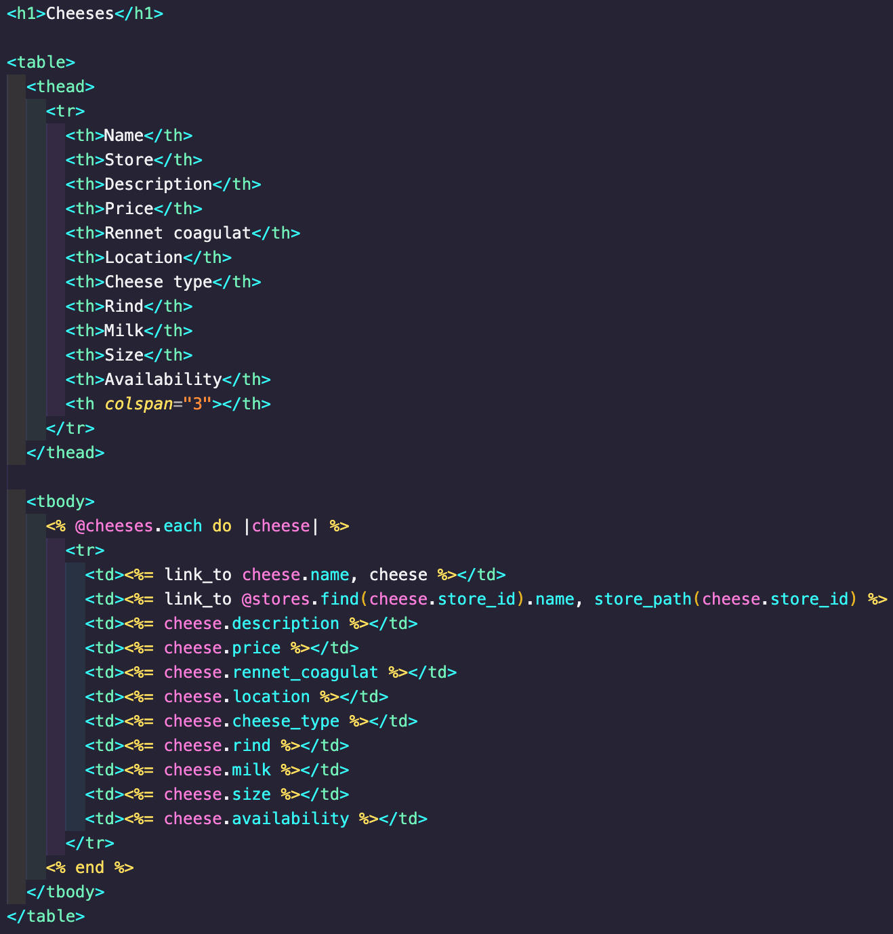
GENERIC CODE PICTURE
insert some random code found on google or something

Slide 7
INSERT APP WALKTHROUGH HERE

Slide 8
ANY QUESTIONS? IF NOT THEN THAT IS THE END

